Slide 1
Lagrangian Perturbation Theory : 3rd order solutions for general dark energy models
Seokcheon Lee (이석천)
Korea Institute for Advanced Study
(고등과학원)
Feb. 12th. 2014
based on : arXiv/1401.2226

Slide 2
Outline
Why do we need LPT?
Analytic Perturbation Theories
Standard Perturbation Theory (SPT)
Lagrangian Perturbation Theory (LPT)
Application
Matter power spectrum
Two point correlation function
Third order solutions for general DE models
Future works

Slide 3
Why do we need LPT?
Upcoming large-scale surveys (LSST & Euclid) requires huge number of mock catalogs to estimate covariance matrix
N-body simulations : accurate, numerically expensive
Semi-analytic methods (PThalos, PINOCCHIO, COLAR) : fast, inaccurate : using LPT to displace particles at large scales

Slide 4
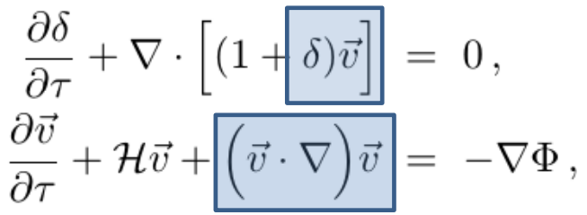
Analytic Perturbation Theories Standard Perturbation Theory (SPT)
Both background evolution and perturbed quantities are required to study Large scale structure (LSS)
Linear theory well describes LSS in linear regime

Slide 5
SPT II
There’s no reason to stop at linear order
Problems : convergences of an expansion are not clear, diverge at large k (cannot do FT), confined in real space

Slide 6
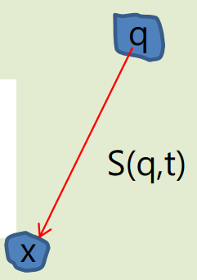
Lagrangian Perturbation Theory (LPT)
In LPT, a fundamental variable to represent perturbation is a displacement field, S
First order LPT : Zel’dovich approximation
Initial conditions for N-body simulations are open generated using ZA or 2nd order LPT
LPT can overcome problems of SPT

Slide 7
LPT II
Drawbacks of LPT
Successful at high redshifts but poor results at late times due to shell crossing
Power in small scales is suppressed
Multiple streams through same Eulerian position
Before shell crossing, the system described by a velocity field

Slide 8
Applications
Predictions for cosmological dependence (including Ωm ,ω, etc) on
(quasi-linear) power spectrum
Weak lensing
Bispectrum
Halo bias
Two point correlation function (BAO)

Slide 9
Third order solutions : for general dark energy models
Goal
So far one uses EdS universe approximation for the time dependence part of solutions
Thus, one investigates 2pt CF or PS for ΛCDM model with this assumption
This is self inconsistent and can’t be used for the cosmological model different from ΛCDM
One needs to improve this in order to predict DE dependence on those observable

Slide 10
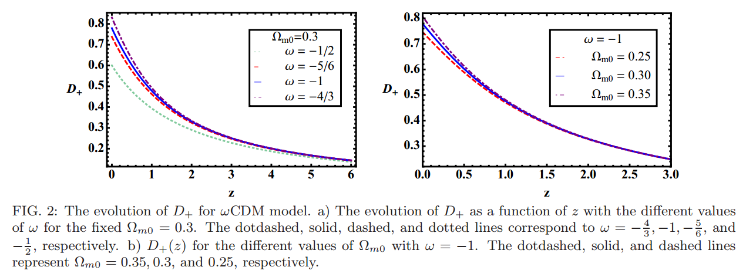
1st order solution

Slide 11
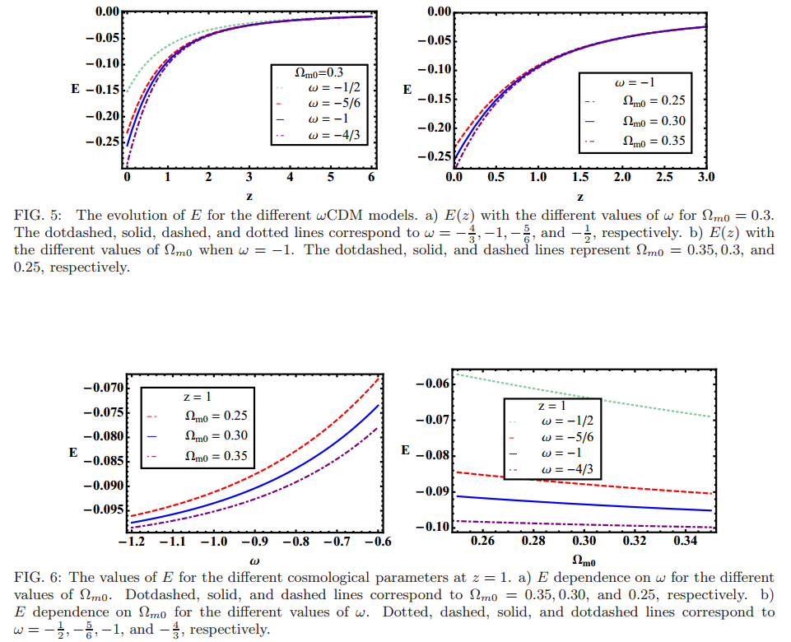
2nd order solution

Slide 12
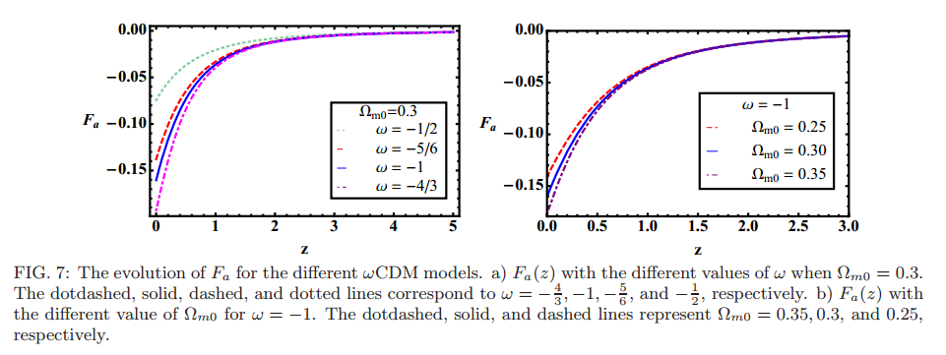
3rd order solutions : Fa

Slide 13
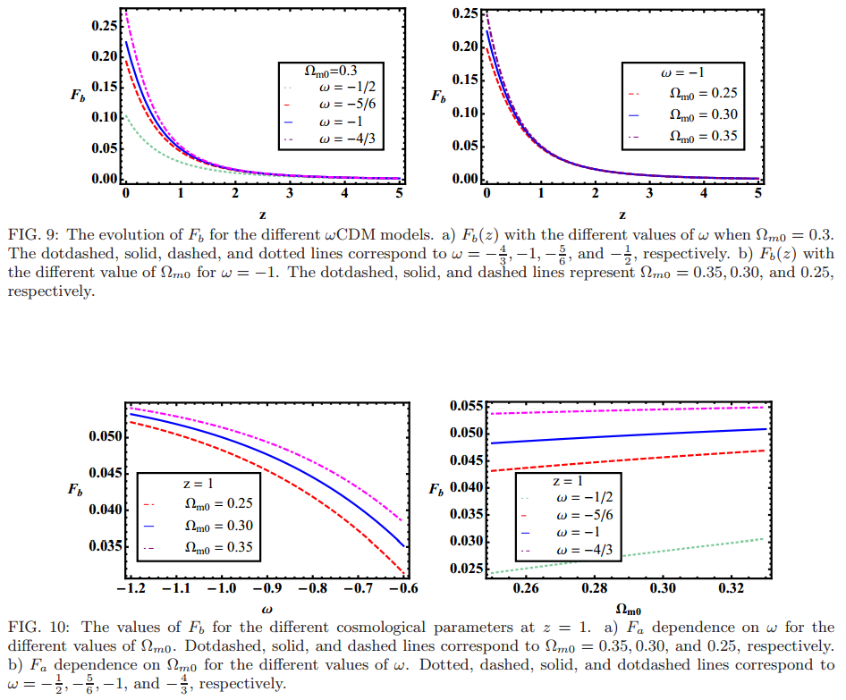
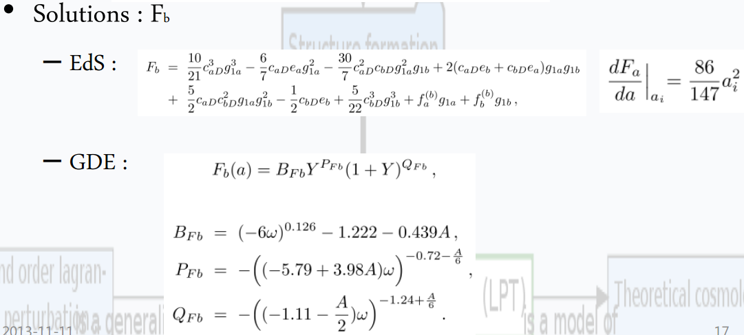
3rd order solutions : Fb

Slide 14
Future works
Adopt the correct higher order solutions to power spectrum (in progress)
Using these solutions in the 2pt correlation function to forecast BAO signals (in progress)
Also check the prediction for WL

